Slide 1

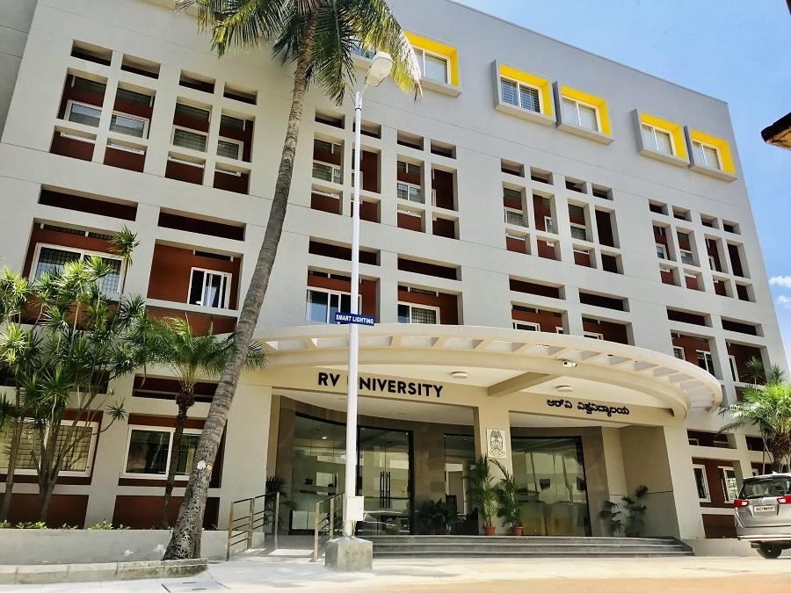
Semester –VI Professional Elective - IV CS3239-Data Warehousing and Mining
CIE-3 Mini Project 17-04-25

Slide 2
Lung Cancer Prediction Using Orange Machine Learning Tool and Covid Prediction using Knime
K Akanksha Raju (1RVU22BSC039)
Shrayaas Deepak (1RVU22BSC096)
Rachana MS (1RVU22BSC078)

Slide 3
Introduction
This project involves applying machine learning and data analytics techniques to two important public health challenges: lung cancer detection and COVID-19 trend analysis.
The first part uses the Orange Machine Learning platform to classify individuals as having lung cancer or not based on symptoms and personal health data.
The second part applies KNIME analytics for time series analysis and clustering of global COVID-19 case trends.
Together, these tools demonstrate how visual programming platforms can support healthcare diagnostics and pandemic monitoring through data mining.

Slide 4
Relevance / Importance of the Chosen Topic
Soil Fertility
Soil fertility is vital for agricultural productivity.
Manual testing is labor-intensive, costly, and time-consuming.
Machine learning enables fast, accurate, and automated soil classification.
Supports data-driven decisions in smart farming and sustainable agriculture.
Delhi Air Quality
Delhi faces critical air pollution challenges, impacting public health.
Time series forecasting helps in predicting PM2.5 levels.
Clustering identifies seasonal pollution patterns for better planning.
Useful for early health warnings, policy decisions, and resource allocation.

Slide 5
Description of the Project & tool
Tool 1: Orange ML Tool
Purpose: Classify lung cancer status based on health indicators
Dataset: 309 instances, 16 attributes (e.g., smoking, fatigue, chest pain, wheezing)
Target variable: LUNG_CANCER (Binary classification)
Techniques Used:
1.Logistic Regression
2.k-Nearest Neighbors (kNN)
3.Random Forest
4.Decision Tree
Evaluation: Cross-validation and confusion matrix

Slide 6
Description of the Project & tool
Tool 2: KNIME Analytics Platform
Purpose: Analyze and cluster global COVID-19 time series data
Dataset: 231,744 records, including daily case data for confirmed, recovered, and deaths across countries
Features:
1.Date-wise aggregation by country
2.Clustering countries based on case trends (e.g., k-Means)
Techniques Used:
1.Time Series GroupBy and Line Plots
k-Means Clustering

Slide 7
Data Source: COVID-19 Global Time Series Dataset
1. Attributes: Daily reported cases by country (Confirmed, Recovered, Deaths)
2. Granularity: Country/Region and Province/State-wise data with daily updates
3. Total Records: 231,744 rows
4. Time Attribute: Date (daily granularity for each country/region)
Data Source: Lung Cancer Symptom Dataset
1. Attributes: Symptoms and personal health indicators relevant to lung cancer (e.g., smoking habits, coughing, chest pain)
2. Target Label: LUNG_CANCER – Binary classification (Yes/No)
3. Granularity: Individual-level records representing each patient's symptom profile
4. Total Records: 309 rows
5. Feature Count: 15 input attributes + 1 target label
6. Data Type: All attributes are numeric (binary/categorical values)

Slide 8
Implementation
Soil Fertility Classification (Orange):
Loaded dataset using File widget; applied Z-score normalization.
• Trained kNN, Random Forest, Logistic Regression using Test & Score.
• Evaluated using cross-validation and confusion matrix.
Delhi AQI Time Series & Clustering (KNIME):
Aggregated pollutants monthly using GroupBy..
Applied k-Means clustering to find seasonal pollution patterns.

Slide 9
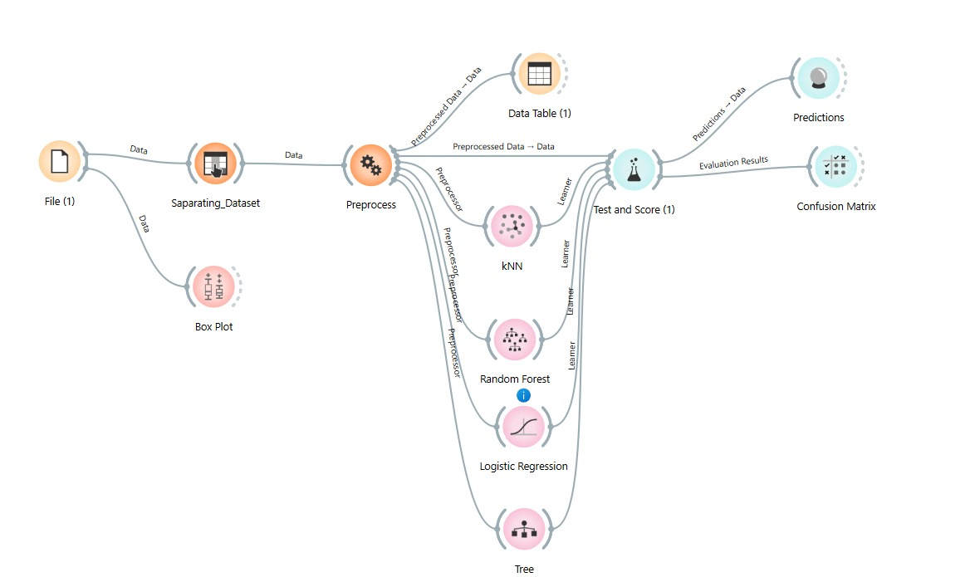
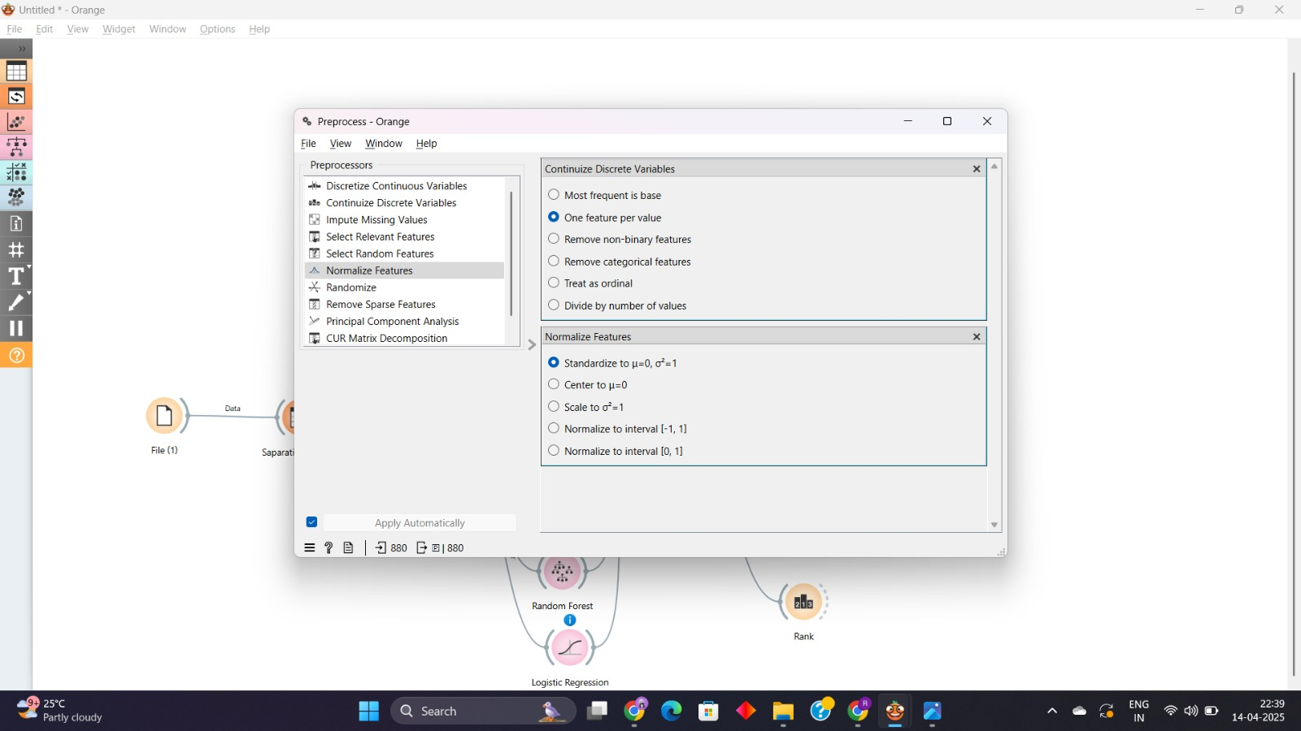
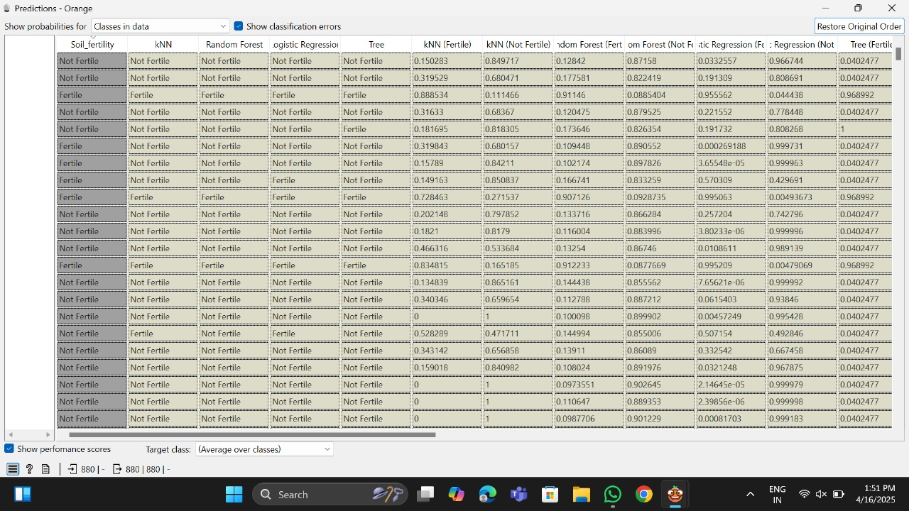
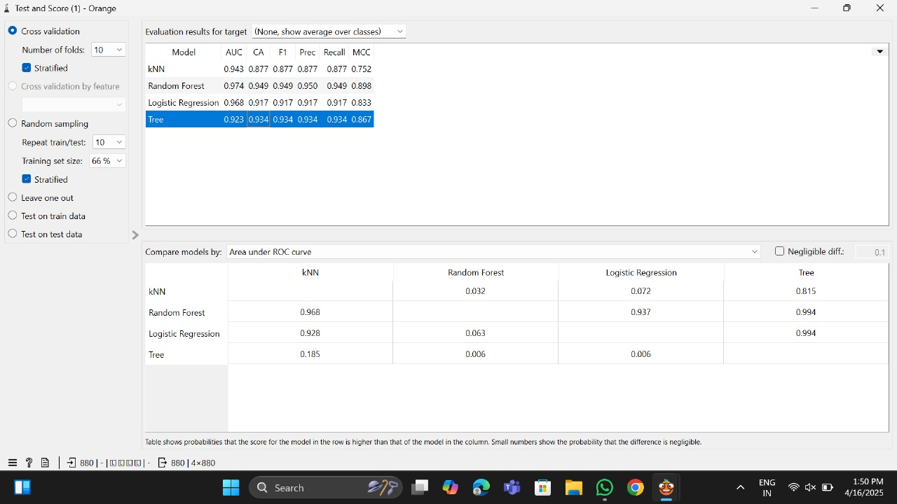
Screen Shots

Slide 10
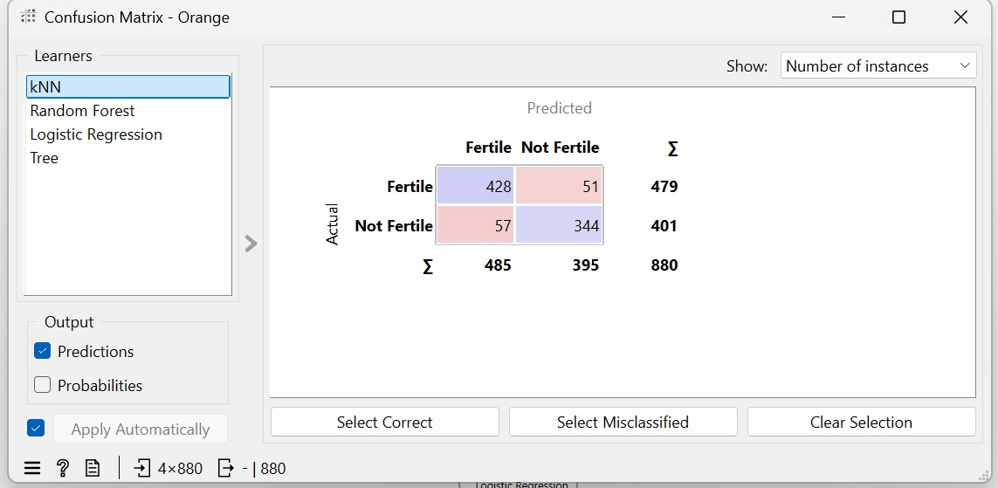
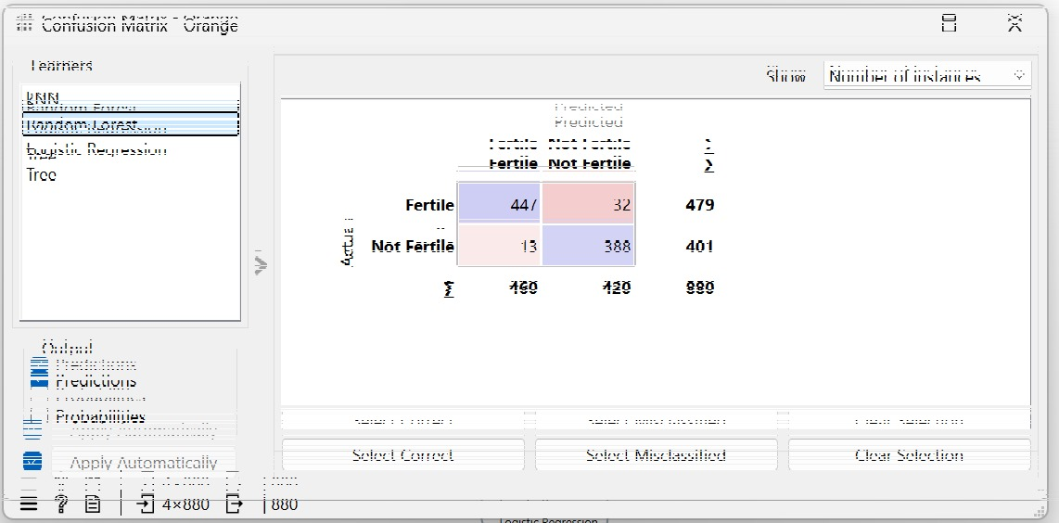
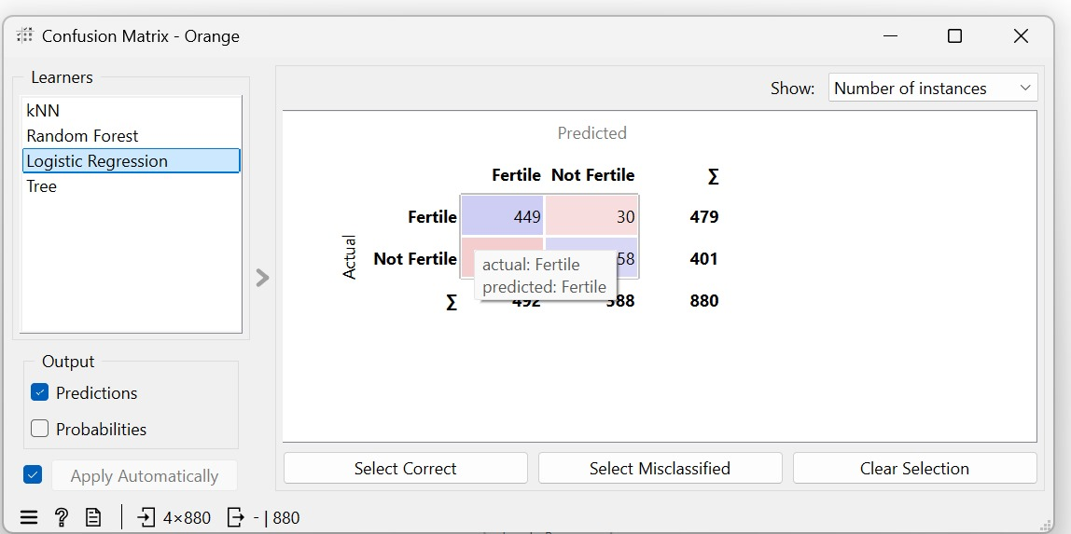
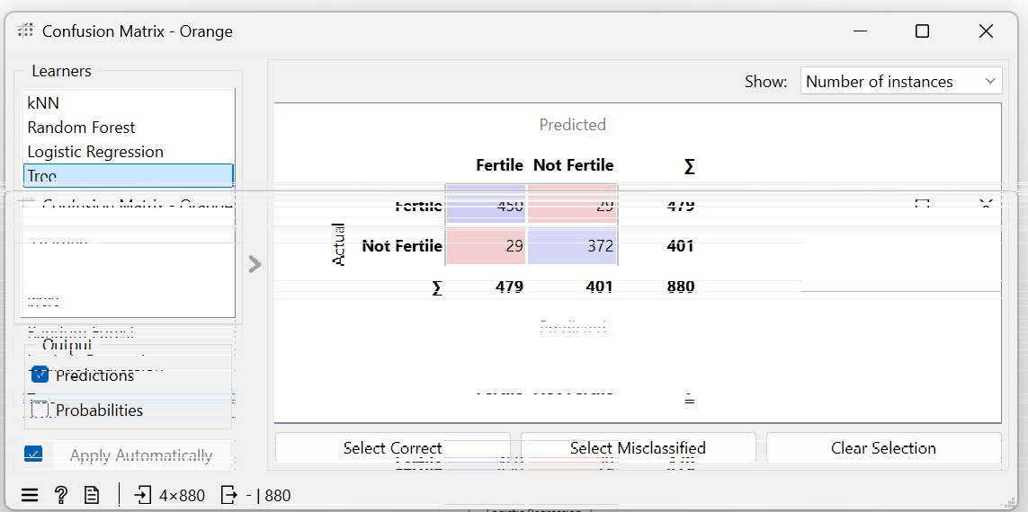

Slide 11
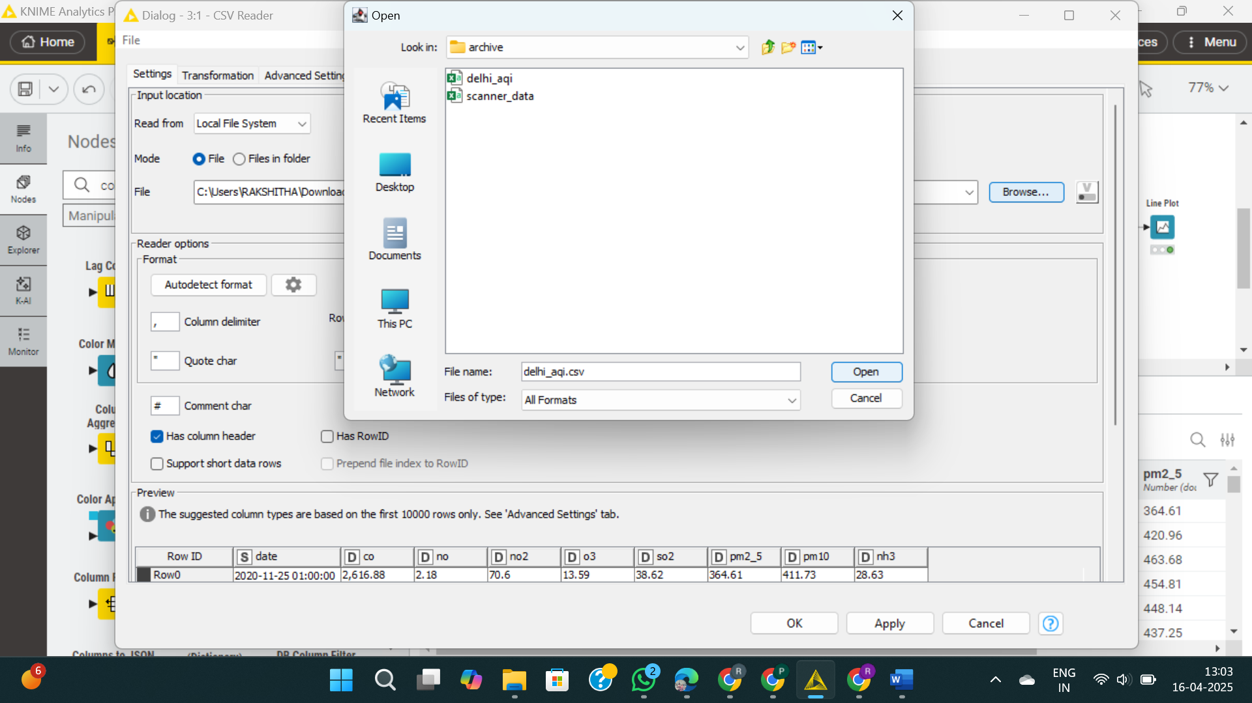
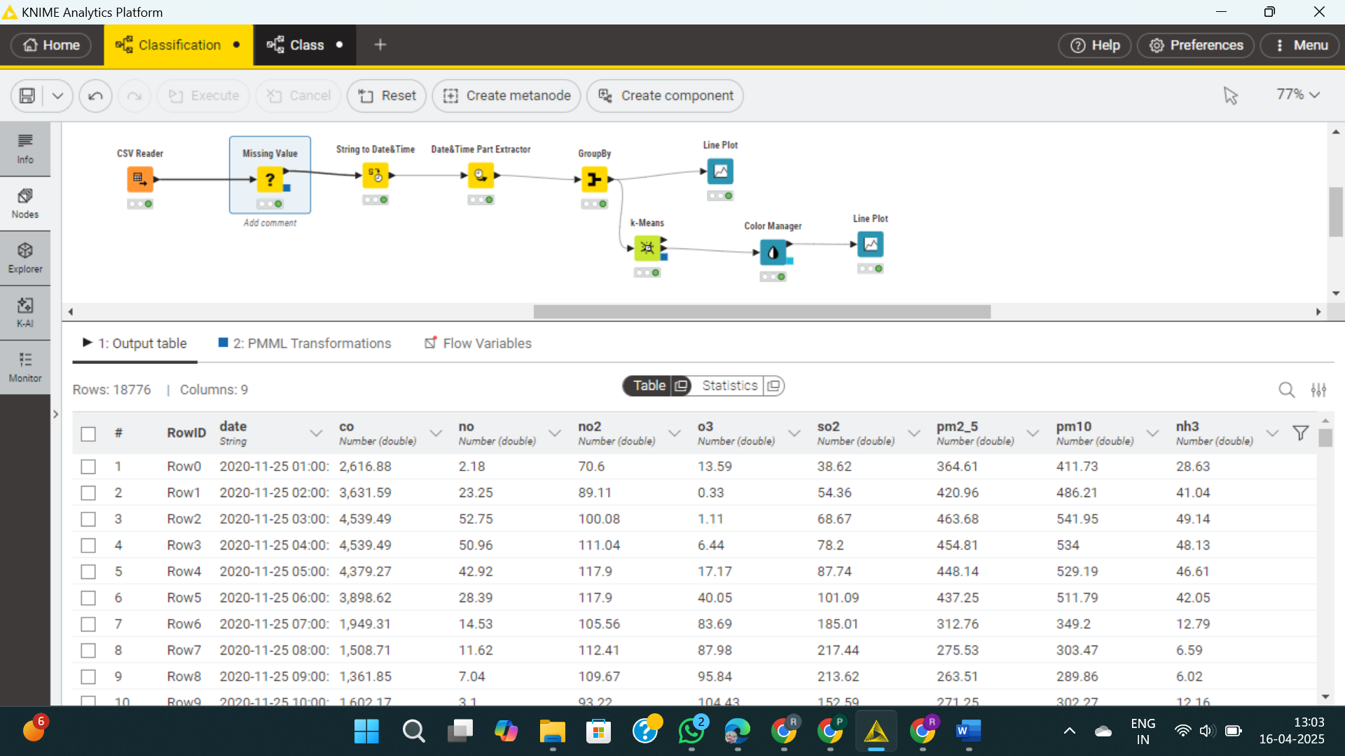
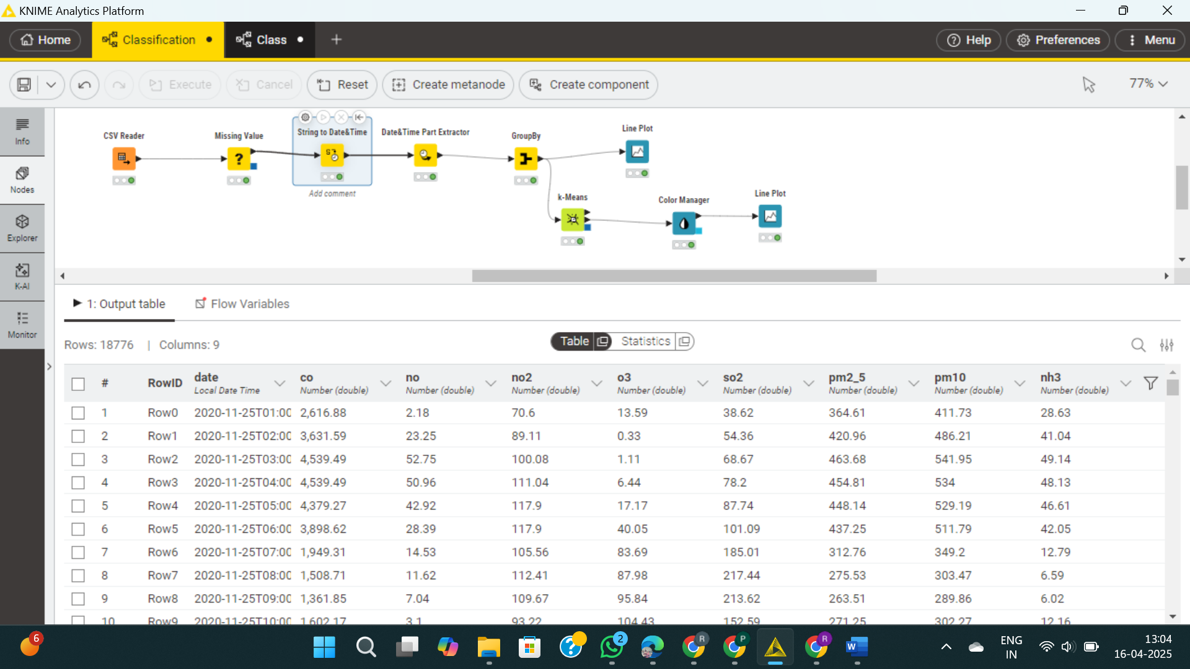
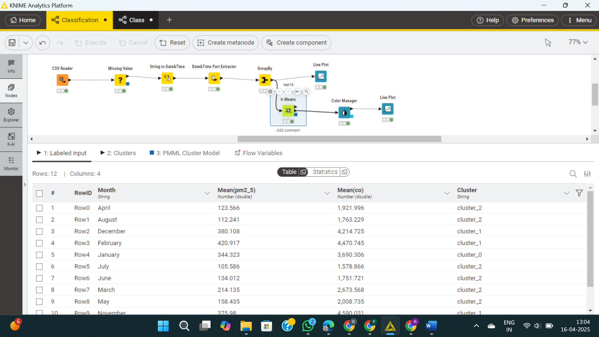

Slide 12
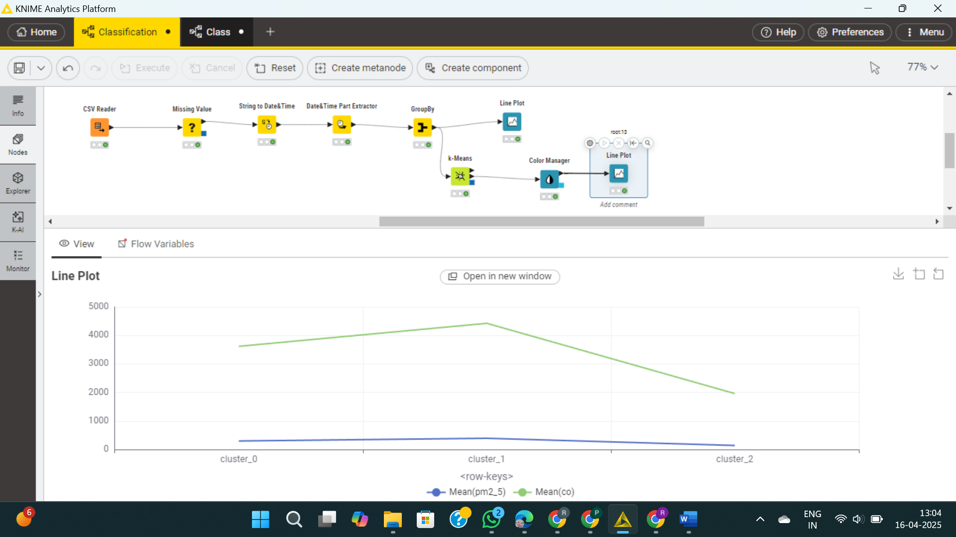

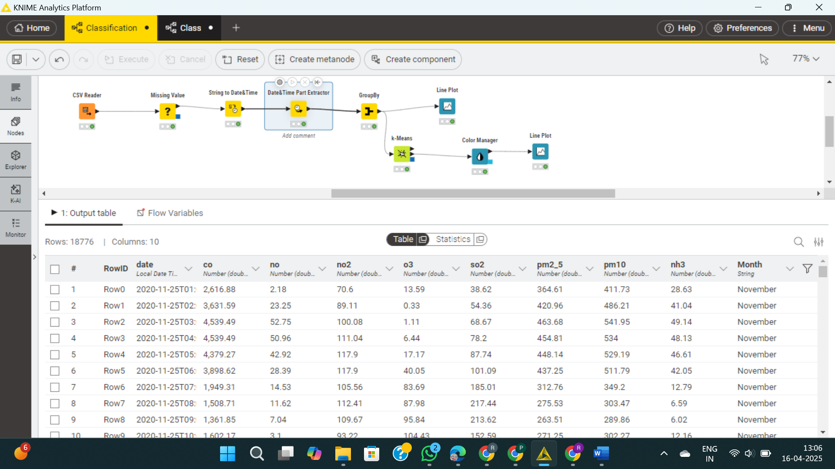
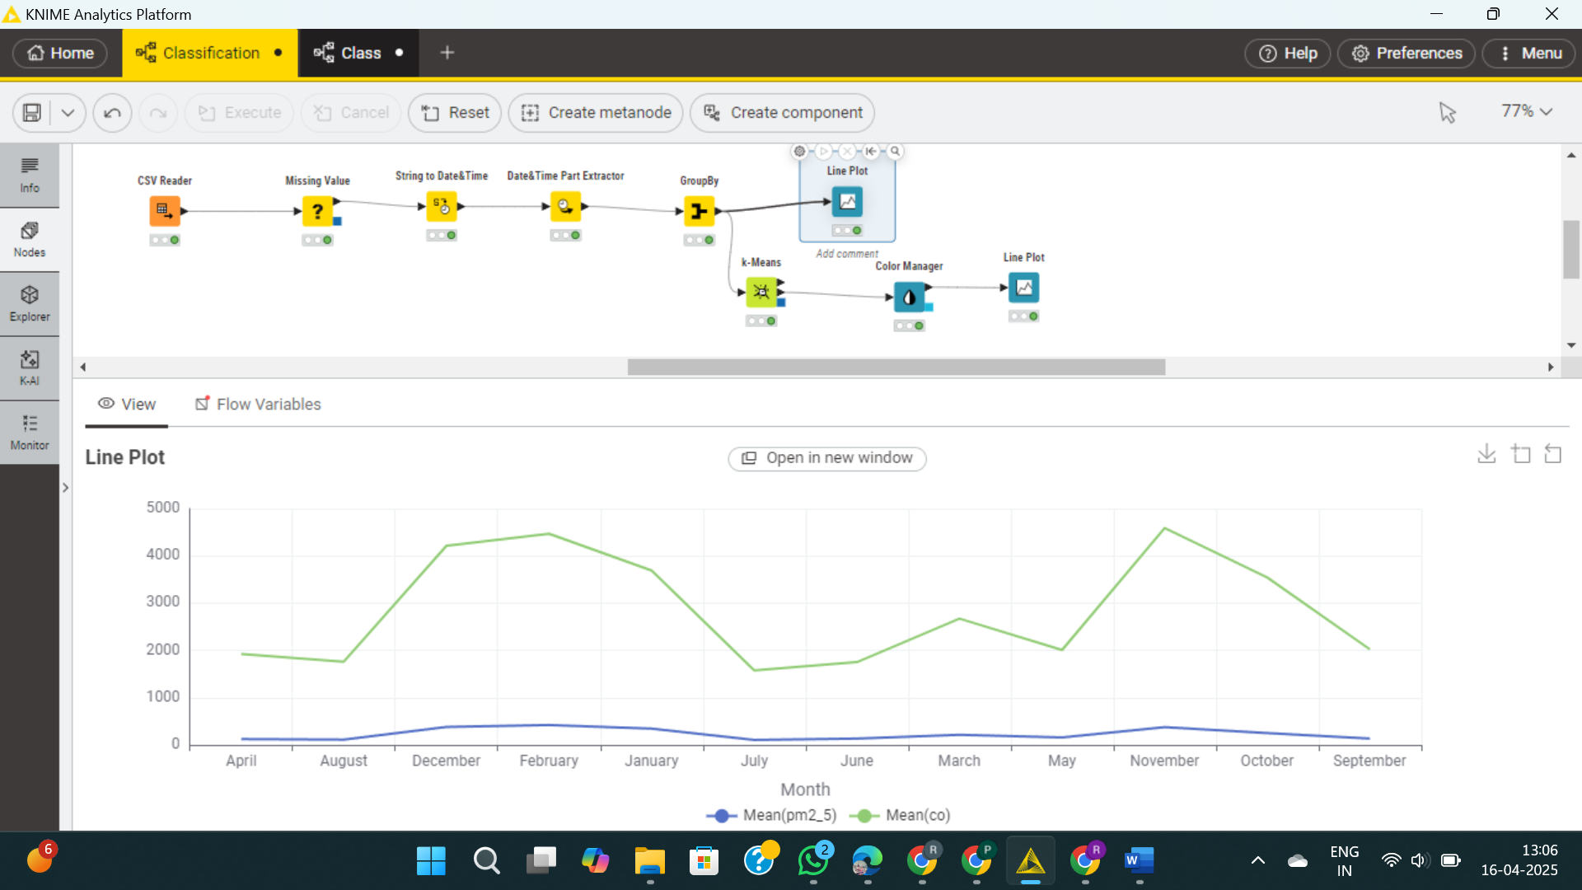

Slide 13
Applications
Lung Cancer Classification (Orange ML Tool)
Early prediction of lung cancer using symptom-based machine learning models
Helps in non-invasive screening and triage in healthcare settings
Supports awareness and preventive strategies for high-risk individuals
Enables fast and cost-effective diagnostic assistance using visual ML tools
COVID-19 Time Series Analysis & Clustering (KNIME)
Monitors and visualizes pandemic trends over time across countries
Identifies similar outbreak patterns through clustering for comparative analysis
Assists policymakers in planning lockdowns and medical supply distribution
Provides data-driven support for early warning systems and future preparedness

Slide 14
Limitations / Challenges
Lung cancer dataset is small, limiting model generalization.
Feature names contain inconsistencies that may affect preprocessing.
COVID data may have missing or delayed entries affecting trend accuracy.
k-Means clustering assumes spherical groups, which may not capture real-world patterns.

Slide 15
Conclusion
Random Forest gave best results for soil classification.
Clustering revealed monthly air quality patterns.
Demonstrates practical use of Orange & KNIME for data mining.

Slide 16
References
[1] Orange Data Mining, “Orange: Data Mining Fruitful & Fun,” [Online]. Available: https://orangedatamining.com. [Accessed: Apr. 17, 2025].
[2] KNIME, “KNIME Analytics Platform,” [Online]. Available: https://www.knime.com. [Accessed: Apr. 17, 2025].
[3] Johns Hopkins University, “COVID-19 Data Repository by the Center for Systems Science and Engineering (CSSE),” [Online]. Available: https://github.com/CSSEGISandData/COVID-19. [Accessed: Apr. 17, 2025].
[4] A. Jain and R. Kumar, Machine Learning for Healthcare Diagnostics. Singapore: Springer, 2020.
[5] M. R. Berthold et al., “KNIME: The Konstanz Information Miner,” in Studies in Classification, Data Analysis, and Knowledge Organization, Berlin, Germany: Springer, 2008.
[6] Open-source Medical Dataset (Lung Cancer), [Online]. Available: [dataset source if known—else keep this as a generic reference].

